Slide 1

SOCOM SOFNET-U/S
Account Paperwork Instructions
Please fill out the forms completely and make sure to follow the instructions provided in this PowerPoint very carefully. Failure to do so will delay and/or prevent the account from being created in a timely manner.
A few other things that hold users up on accounts is not sending a current DoD Cyber Awareness Challenge certificate and not having access in JPAS. The DoD Cyber Awareness Challenge certificate must be current and up to date within the last year. The SOCKOR security officer needs to sign off on the 2875 and if you are not visible or verified in JPAS, he/she cannot sign off on the document. This usually happens when someone has not in-processed with their S2.
ALL DOCUMENTS MUST BE FILLED OUT DIGITALLY.
When saving your documents, please follow this method: Last Name, First Name MI Rank Unit (ex. Doe, John D MAJ 1SFG)
REQUIRED DOCUMENTS:
Completed SOCOM SOFNET documents - Doe, John D MAJ 1SFG 2875 SOFNET
DoD Cyber Awareness Challenge Certificate - Doe, John D MAJ 1SFG IA CERT
Info Text File - Doe, John D MAJ 1SFG INFO
Please direct any questions to sockor/soj6helpdesk@socom.mil

Slide 2
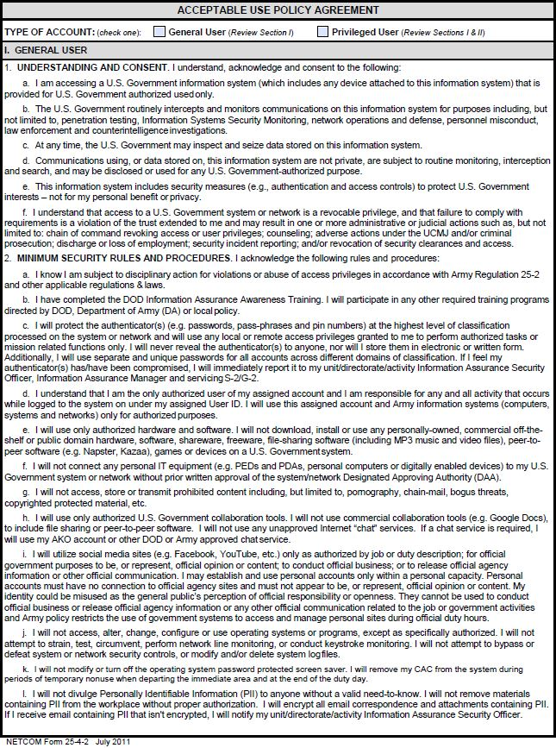
Click on which account you are applying for

Slide 3
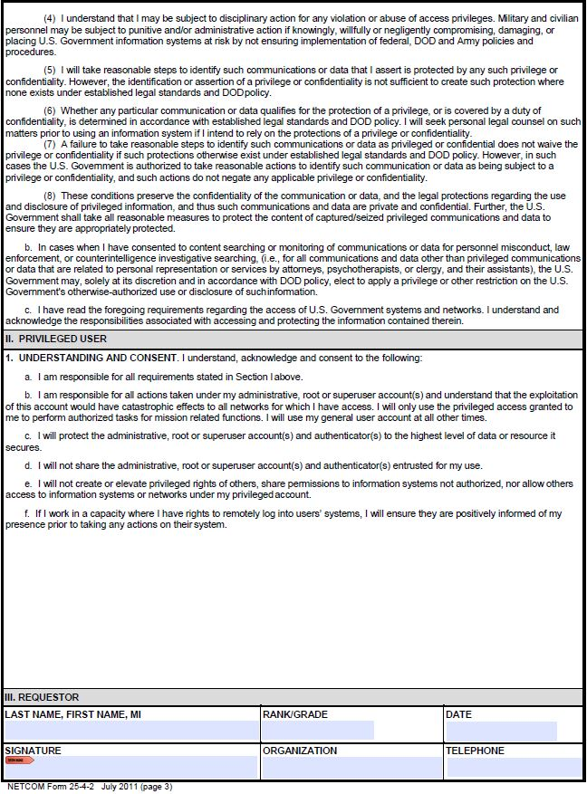
Input Information
Input Information
Input Information
Digitally Sign
Input Information
Input Information

Slide 4
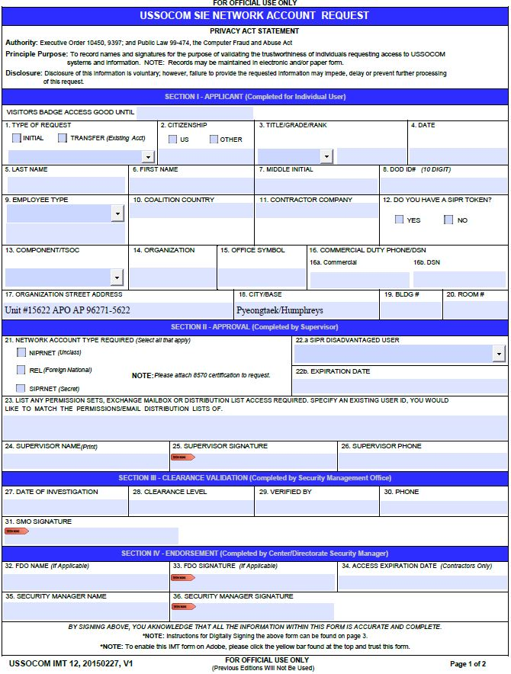
Select Date
Select Title
Select Transfer from location
Select Date
Input Information
Input Information
Input Information
Input Information
Select Type
Input Information
Input Information
Select TSOC
Input Information
Input Information
Input Information
Input Information
Input Information
Check all that apply
Select option
Input Information
Name of member with desired permissions
Input Information
Supervisor Digitally Sign
Input Information

Slide 5
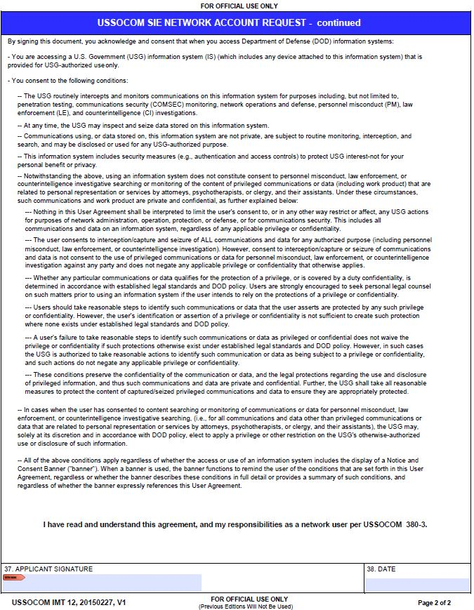
User Digitally Sign
Select Date

Slide 6
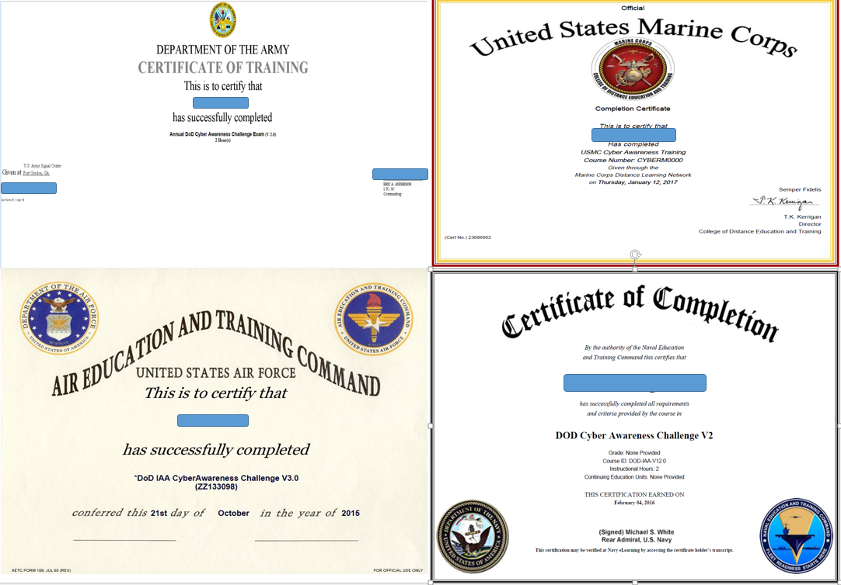
DoD Cyber Awareness
Challenge Certificate
The JKO equivalent is also acceptable (not shown).

Slide 7
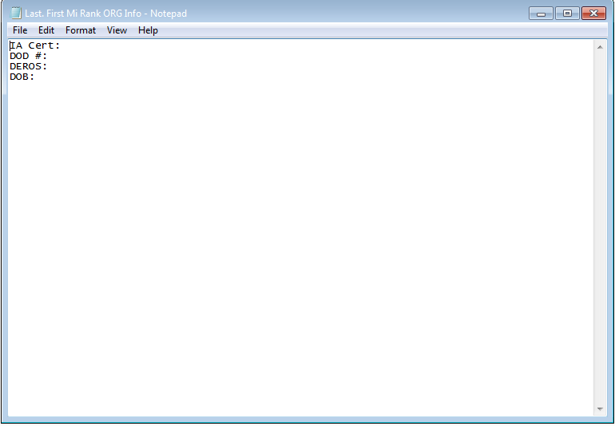
Date Completed
Date leaving SOCKOR
Date Format 20180308
Info Document

